Slide 1







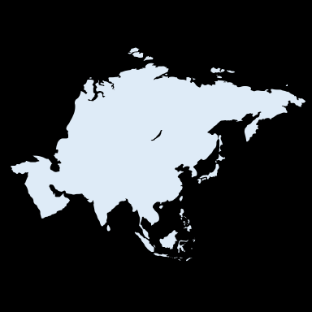


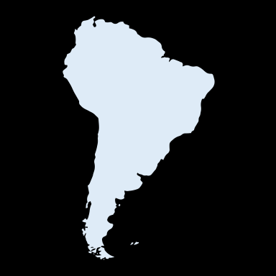




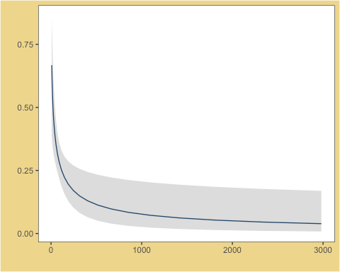







:
IDENTIFYING KNOWN UNKNOWNS
ADDRESSING FEATURES CONTRIBUTING TO DATA DEFICIENCY IN CONSERVATION STATUS OF SHARK SPECIES
John S. Liu¹, Lucy T. Nguyen², Evan E. Batzer³, Damien Caillaud⁴, Nann A. Fangue¹, Alexandra G. McInturf¹
¹ Department of Wildlife, Fish, Conservation Biology - UC Davis | ² Department of Neurobiology, Physiology and Behavior - UC Davis
³ Department of Plant Sciences - UC Davis | ⁴ Department of Anthropology - UC Davis
INTRODUCTION
METHODS
“A taxon is Data Deficient (DD) when there is inadequate information to make a direct, or indirect, assessment of its risk of extinction based on its distribution and/or population status. A taxon in this category may be well studied, and its biology well known, but appropriate data on abundance and/or distribution are lacking.” (IUCN, 2019)
Collecting Data
Relevant information for all
shark species identified in the
Pocket Guide for Sharks Around the World (Ebert et al. 2015) was compiled using the guide and the Fish Base online database.
THE FACTS
Sharks demonstrate a tremendous amount of diversity in life history among taxa, and as such can provide varying ecosystem functions.
45%
Relevant Variables
15.9% of known shark species are currently threatened with extinction; however, 44.9% are still data deficient. (IUCN, 2019)
55%
The relevant data for each species included information on biology, human use, and the environment.
Given the high number of DD species, proper assessment of shark populations worldwide is challenging.
Biology → Size and Reproductive Strategy
Human Use → Fishery, Aquarium, and Gamefish
Environment → Geographic Range, Depth, Climate Zone, and Habitat Type
OUR STUDY
According to the IUCN Red List, nearly 45% of shark species evaluated were classified as data deficient.
Data Analysis
In this preliminary study, we review 501 recognized shark species to analyze potential biological and ecological factors that may contribute to data deficiency.
The data was post-processed and analyzed using a generalized logistical model to identify variables with a significant effect on data deficiency.
RESULTS
N/A
Arctic
33.0%
Atlantic
8.6%
freshwater / brackish*
30.4%
Pacific
N/A
18.1%
Indian*
coastal + benthic*
Antarctic
0 meters
freshwater / brackish
24.1%
30.4%
18.9%
24.3%
21.4%
pelagic + fisheries interest
23.9%
0m – 200m
coastal*
coastal + fisheries interest*
pelagic
c o a s t a l
200 meters
35.8%
benthic*
26.4%
200m – 1000m
0.75
31.2%
benthic + fisheries interest
28.9%
deepwater
0.50
Probability of Data Deficiency*
35.2%
deepwater + benthic
32.1%
deepwater + fisheries interest
1000 meters
0.25
d e e p w a t e r
21.2%
1000m – 4000m
0
0
1000
2000
3000
Average body size (cm)
%
= % probability of being DD
*
= statistically significant
4000 meters
DISCUSSION
FUTURE DIRECTIONS
Our analysis indicates that sharks that are benthic, coastal, or small are most likely to to be classified as data deficient according to the IUCN Red List.
This study has already unveiled a deeper understanding of data deficiency in shark species, and will be improved through the following measures:
Policy
and
Planning
1.
Supplementing data from the Pocket Guide for Sharks Around the World and Fish Base with additional data from peer-reviewed literature;
Why This Matters?
IUCN
Red List
Classification
Government
and
Non-Government
Agencies
Resource
Allocation
Improved
Species
Protection
2.
Updating the species list to account for newly discovered species following the 2015 publication of the Pocket Guide for Sharks Around the World;
Ultimately, these results could be employed to help target data collection to species with such characteristics to improve conservation measures for population recovery.
Inform
and
Educate
3.
Controlling for phylogenetic tree variations by considering multiple possible phylogenies.

